Slide 1
ATAI
Advanced Technique of Artificial Intelligence
ATAI
ChongqingUniversity _{AdvancedTechniqueof}
of Technology Artificial Intelligence
Chongqing University of
Technology
Chongqing University ^{ATAI}
_{of Technology} Advanced Techniqueof
Artificial Intelligence
Chongqing University of Technology
Chongqing University of Technology
Beyond Single Emotion:
Multi-label Approach to Conversational Emotion Recognition
Code : None.
—— AAAI’2025
Reported by Yang Jiang
1

Slide 2
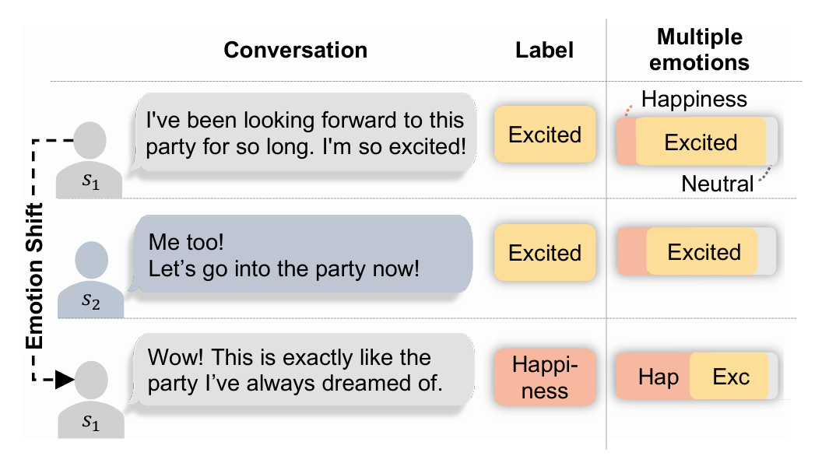
ATAI
Advanced Technique of Artificial Intelligence
ATAI
ChongqingUniversity _{AdvancedTechniqueof}
of Technology Artificial Intelligence
Chongqing University of
Technology
Chongqing University ^{ATAI}
_{of Technology} Advanced Techniqueof
Artificial Intelligence
Chongqing University of Technology
Chongqing University of Technology
Introduction
As illustrated in Figure 1, each utterance within a conversation is assigned to a single label. Although an utterance can encompass multiple emotions (right), only the most intense emotion is retained and other emotions are discarded.

Slide 3
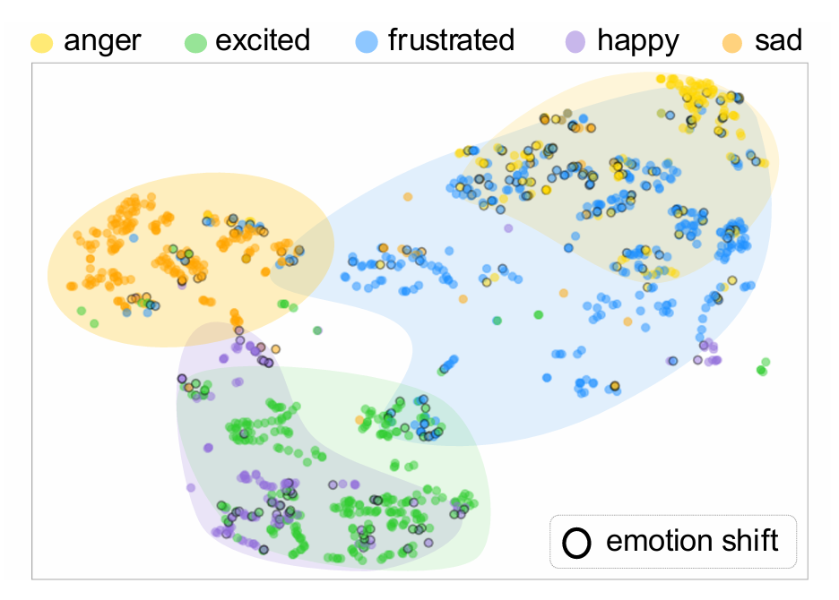
ATAI
Advanced Technique of Artificial Intelligence
ATAI
ChongqingUniversity _{AdvancedTechniqueof}
of Technology Artificial Intelligence
Chongqing University of
Technology
Chongqing University ^{ATAI}
_{of Technology} Advanced Techniqueof
Artificial Intelligence
Chongqing University of Technology
Chongqing University of Technology
Introduction

Slide 4
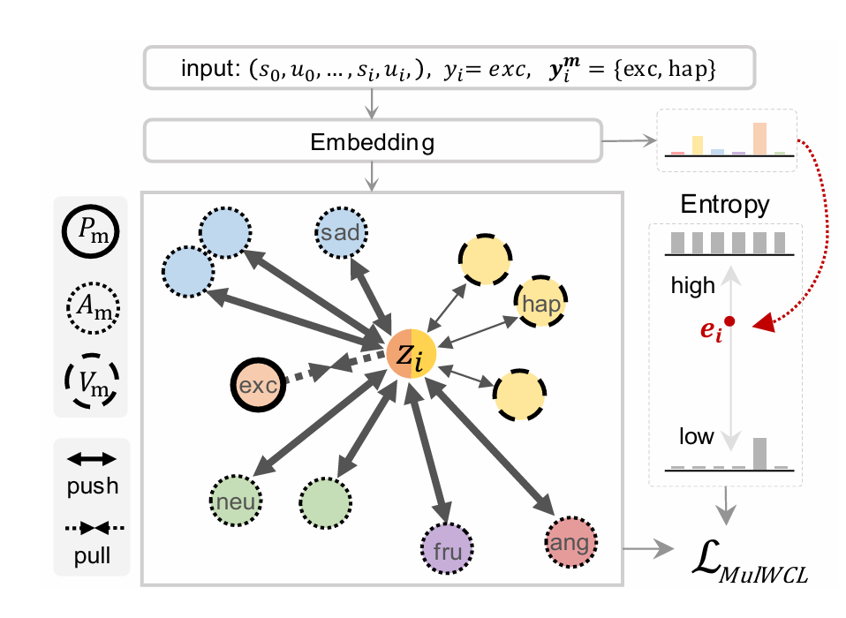
ATAI
Advanced Technique of Artificial Intelligence
ATAI
ChongqingUniversity _{AdvancedTechniqueof}
of Technology Artificial Intelligence
Chongqing University of
Technology
Chongqing University ^{ATAI}
_{of Technology} Advanced Techniqueof
Artificial Intelligence
Chongqing University of Technology
Chongqing University of Technology
Overview

Slide 5
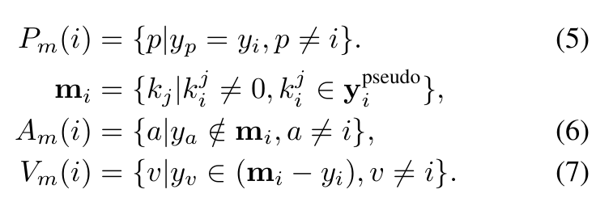
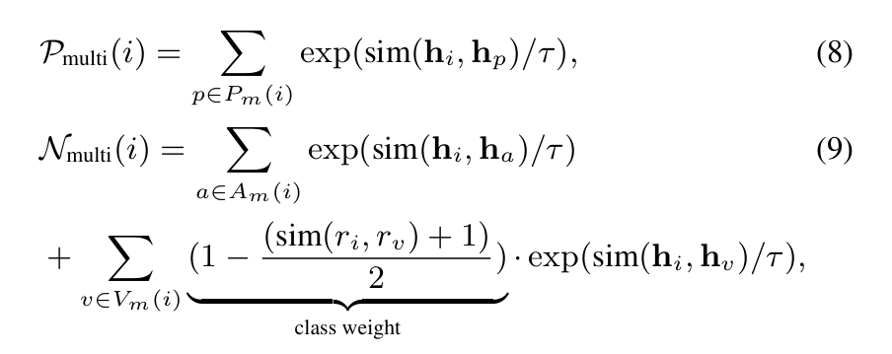
ATAI
Advanced Technique of Artificial Intelligence
ATAI
ChongqingUniversity _{AdvancedTechniqueof}
of Technology Artificial Intelligence
Chongqing University of
Technology
Chongqing University ^{ATAI}
_{of Technology} Advanced Techniqueof
Artificial Intelligence
Chongqing University of Technology
Chongqing University of Technology
Method

Slide 6
ATAI
Advanced Technique of Artificial Intelligence
ATAI
ChongqingUniversity _{AdvancedTechniqueof}
of Technology Artificial Intelligence
Chongqing University of
Technology
Chongqing University ^{ATAI}
_{of Technology} Advanced Techniqueof
Artificial Intelligence
Chongqing University of Technology
Chongqing University of Technology
Method

Slide 7
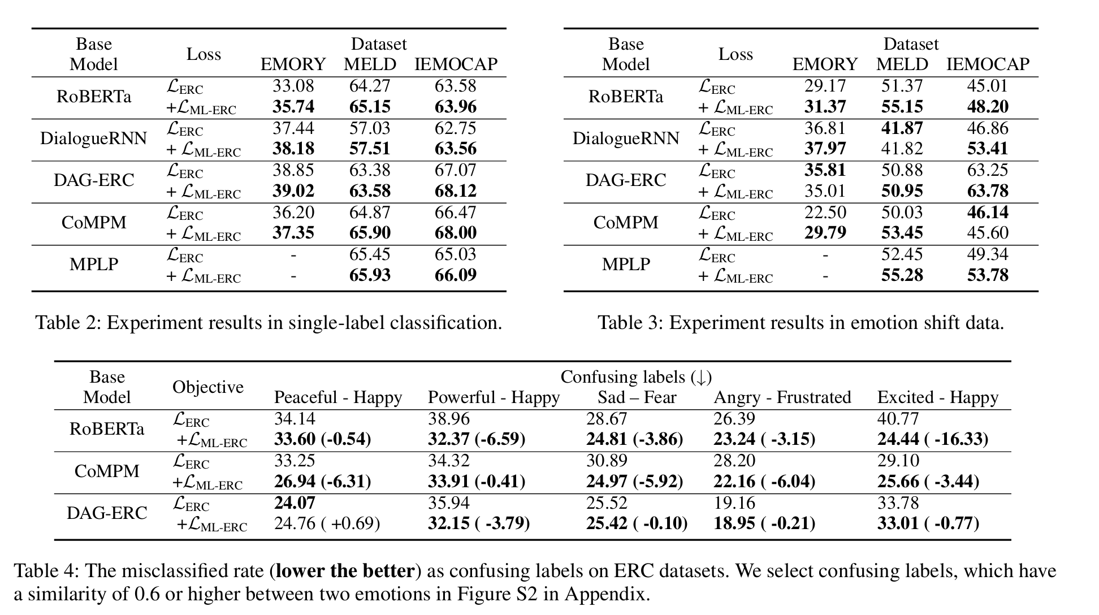
ATAI
Advanced Technique of Artificial Intelligence
ATAI
ChongqingUniversity _{AdvancedTechniqueof}
of Technology Artificial Intelligence
Chongqing University of
Technology
Chongqing University ^{ATAI}
_{of Technology} Advanced Techniqueof
Artificial Intelligence
Chongqing University of Technology
Chongqing University of Technology
Experiments

Slide 8
ATAI
Advanced Technique of Artificial Intelligence
ATAI
ChongqingUniversity _{AdvancedTechniqueof}
of Technology Artificial Intelligence
Chongqing University of
Technology
Chongqing University ^{ATAI}
_{of Technology} Advanced Techniqueof
Artificial Intelligence
Chongqing University of Technology
Chongqing University of Technology
Experiments

Slide 9
ATAI
Advanced Technique of Artificial Intelligence
ATAI
ChongqingUniversity _{AdvancedTechniqueof}
of Technology Artificial Intelligence
Chongqing University of
Technology
Chongqing University ^{ATAI}
_{of Technology} Advanced Techniqueof
Artificial Intelligence
Chongqing University of Technology
Chongqing University of Technology
Experiments

Slide 10
ATAI
Advanced Technique of Artificial Intelligence
ATAI
ChongqingUniversity _{AdvancedTechniqueof}
of Technology Artificial Intelligence
Chongqing University of
Technology
Chongqing University ^{ATAI}
_{of Technology} Advanced Techniqueof
Artificial Intelligence
Chongqing University of Technology
Chongqing University of Technology
Thanks!

